Slide 1

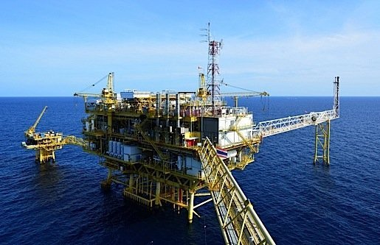
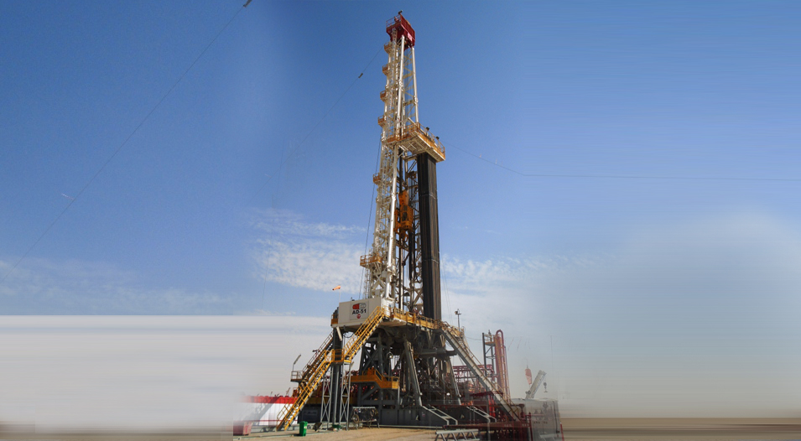
We have consolidated a stronghold in the oil and gas, refinery, petrochemical, firefighting supply industry for over decades – extending to a dozen countries on 4 continents via our sales offices and stockyards. A key factor to RDCO’s continued success is the wealth of experience possessed by our highly professional team. Decades of collective industry know-how in trading, distribution, and procurement make for unified strengths within every facet of our operations.

Slide 2
Core Services
Heavy Equipment, manufacturing Supply
Choke manifold.
Centrifugal pumps.
Pumps.
Valves.
Batch Mixtures / HT-400 Pumps.
Choke panel & High Pressure Test.
Truck Mounted Pumping Units.
Cementing Units.
Mud Systems.
Winches.
Hydraulic Power Pack.
Hydraulic Cylinder Jacks.
Engines.
Mud Pumps.
Shale Shakers.
Deadline Anchor.
Swivel.
Travelling Block & TOPDRIVE.
Crown Block.
BOP Control Unit (KOOMEY UNIT).
Calibration services.

Slide 3
Trading
A key factor to RDCO’s continued success is decades of collective industry know-how in trading, distribution, and procurement make for unified strengths within every facet of our operations.
We are able to provide leading and preferred products – plus highly sophisticated and technical services – to major Oil, Gas, Petrochemical, and Renewable Energy Companies across the Globe.
Our objective is to provide:
⦿ Sound operational and logistics expertise from our sales support
staff.
⦿ Technical support and back up
⦿ Ensure ‘on time’ delivery of quality products
⦿ Managing relationships with professional empathy

Slide 4
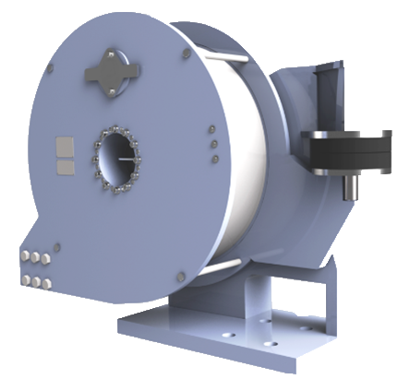
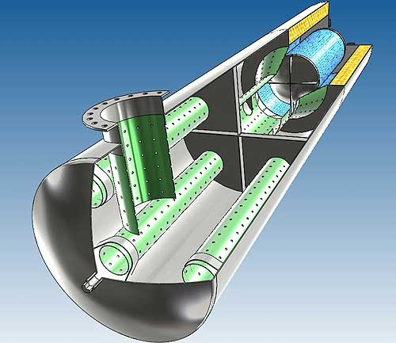
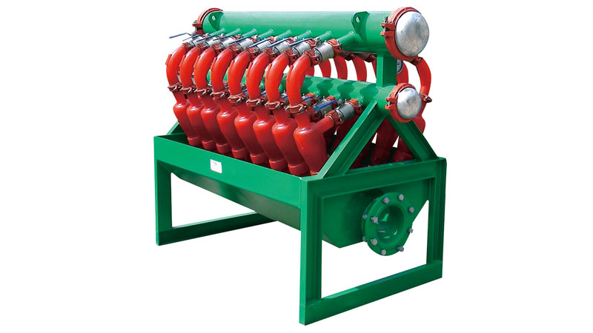
Line Of Product
Wireline Anchors
Industrial Mufflers
Desilter
Air Blowers
Air Compressors
Air Dryers
Air Vents
BOPs
BOP Hoses
BOPs, Annular
BOPs, Ram
BOPs, Components
Brake Rims & Band
Brake Blocks
Rotary Slips
Rotary hoses
Brakes for draw-works
Bug Blowers
Closing Units
Choke & Kill Hoses
Crossovers, rotary substitute
Casing Elevators
Casing Slips
Casing heads, hangers
Casing Scraper
Roller Chains

Slide 5
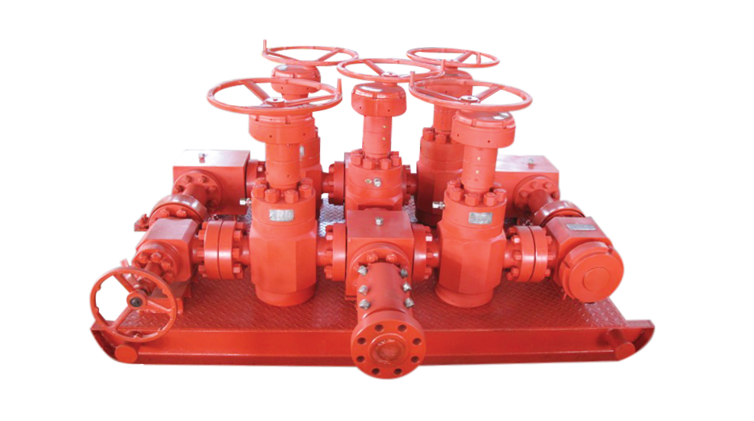
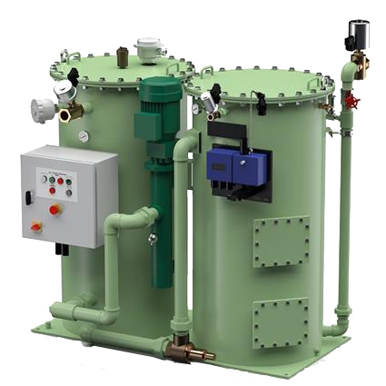
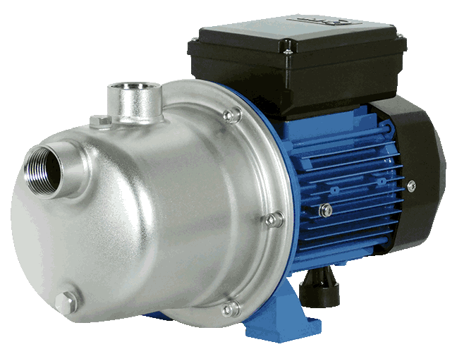
Choke Manifold
Oil Water Separators
Centrifugal pumps
Casing spiders
Chicksan/ Swivel Joints
Cementing equipment
Cementing guide shoes
Centrifuges, drilling mud/fluid
Chokes Manifold Skids
Circulation heads
Compressors
Core barrels, drilling rig
Coring equipment
Deck Scalars.
Pressure Transmitters
Derrick
Desander
Double Studded Adaptors
Downhole motors
Drilling Choke Control Systems
Drill Bits
Drill Collars
Drill Pipe
Drill Pipe Elevators
Drill Pipe Elevators Slips
Rubber Expansion Joints
Reverse Circulation Junk Baskets
Releasing and Circulating Overshot
Reamers
Ring Joint Gaskets
Rotary Drilling Jar

Slide 6
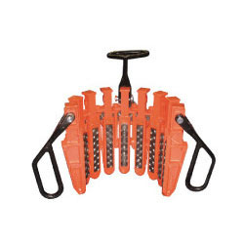
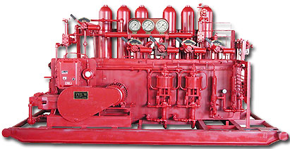
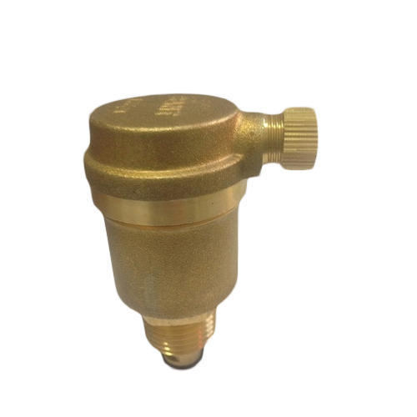
Drill Collar Slips
Koomey B.O.P Control Equipment
Air Vents
Drill Pipe Elevators Slips
Drill Pipe Spinners
Drill pipe wipers
Drill bit breaker plates
Drilling control equipment
Drilling instrumentation
Drilling mud treatment
Electric Test Benches
Fenders
Fire Hoses
Fishing Bumper Sub
Fishing Magnets
Fishing Tools
Fluid End Parts
Gate Valves, Spare Parts
Handling Tools
Hammer Unions
Hammer Seal Unions
Heavy-Weight Drill Pipe
Hole Openers
Hydraulic Casing Tongs
Oil water separators
Personnel Transfer Nets
Pipe Wipers
Pistons
Flow Meters
Pneumatic Tools
Pup Joints

Slide 7
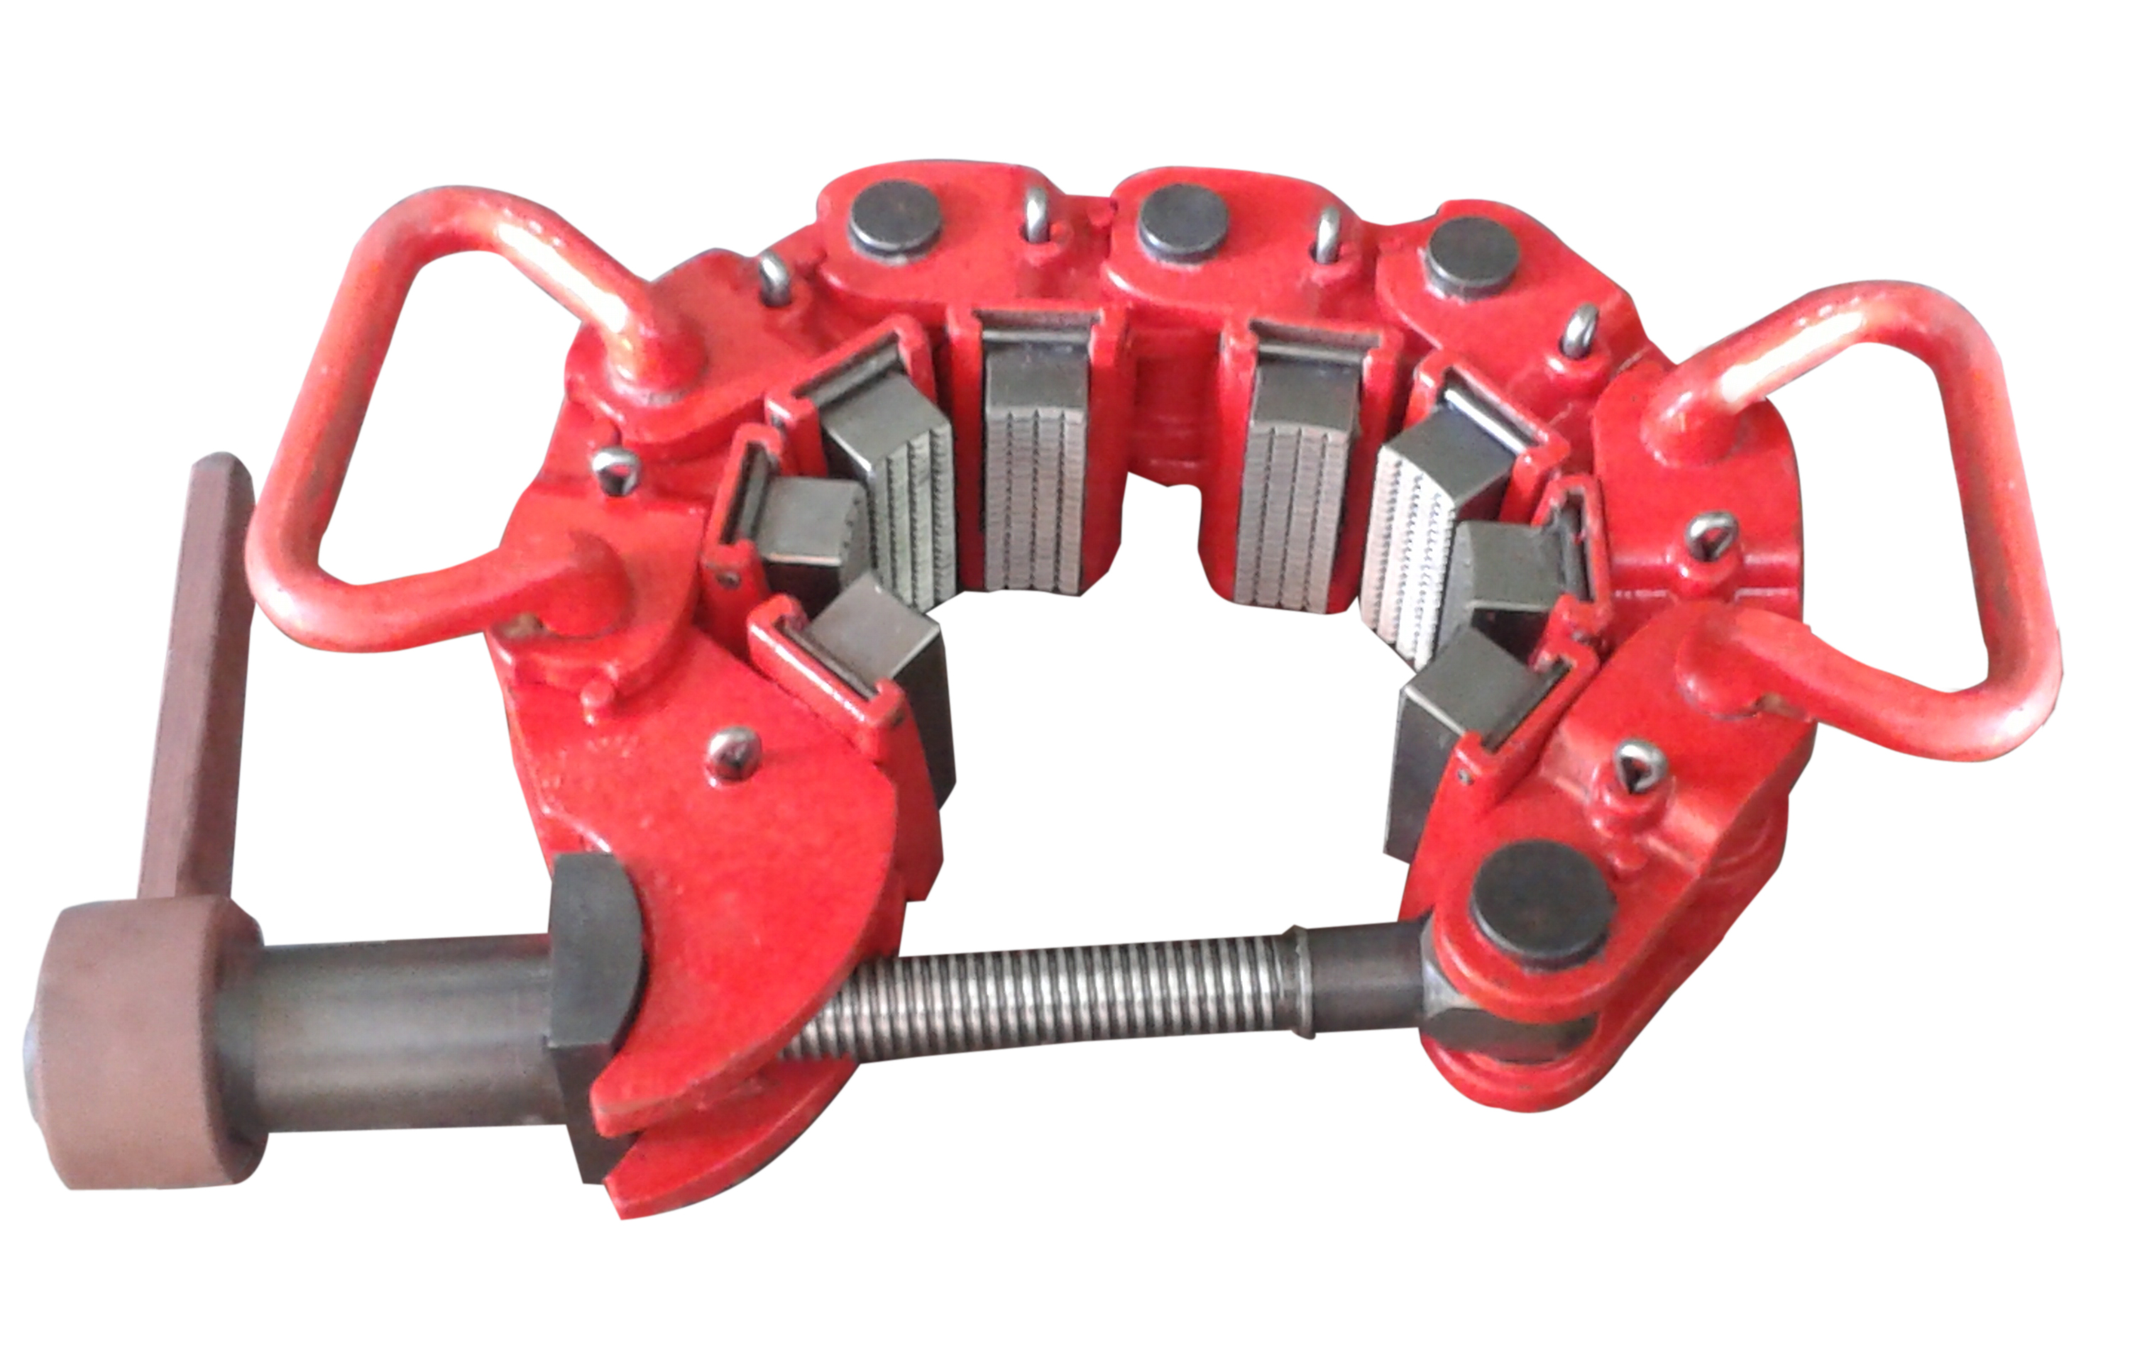
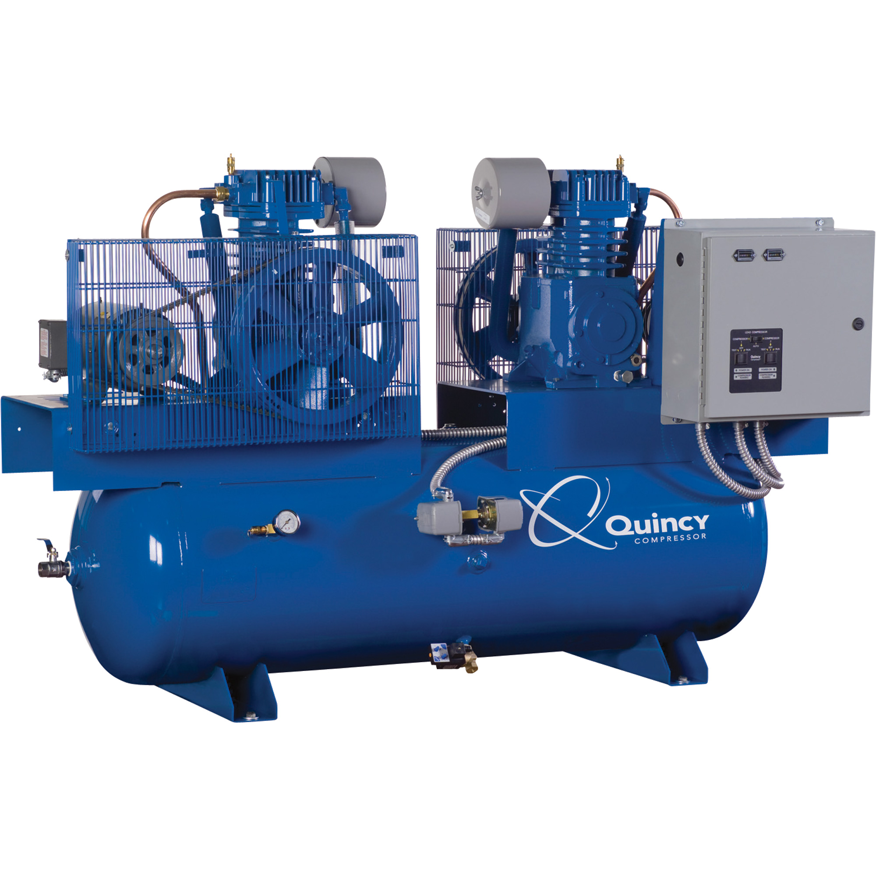
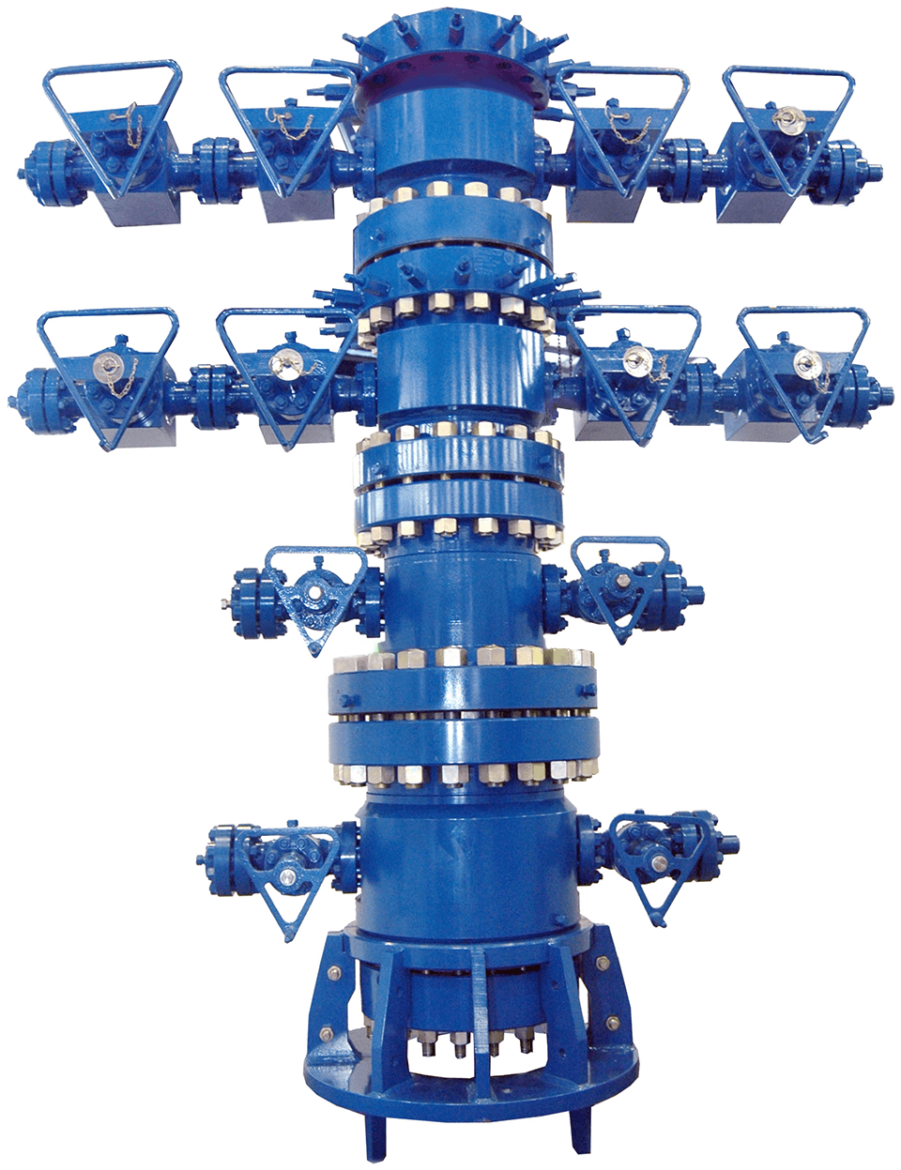
Safety Clamp
Quincy Air Compressors
Well Head
Hydraulic Dead weight Tester
Junk Mill
Junk Catcher Junk Subs
Junk Subs
Kelly Hoses
Kelly’s
Kelly Spinners,
Kelly Valves
Kelly and pipe straighteners
Kelly wipers
Linear Motion Shakers
Manifolds
Manual Tongs
Master Bushings
Mandrels & Sleeves
Mill Control Packer
Mission Pump Parts
Mooring Equipment
Motor Blower
Motors For Hazardous Area
Mud pump Suction Hoses
Mud pit equipment
Mud screens & shale shakers
Mud Treating Equipment
Oil Rig Derrick
Oilfield Pumps, slush

Slide 8
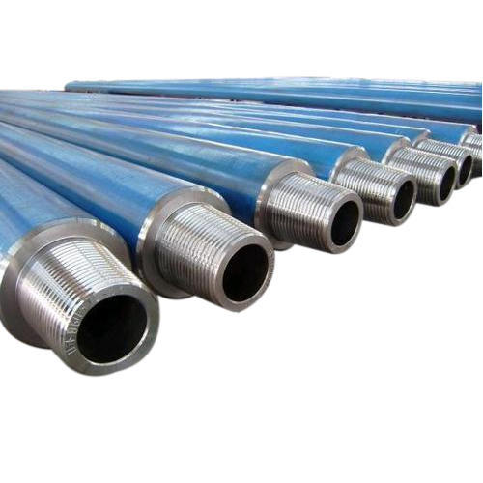
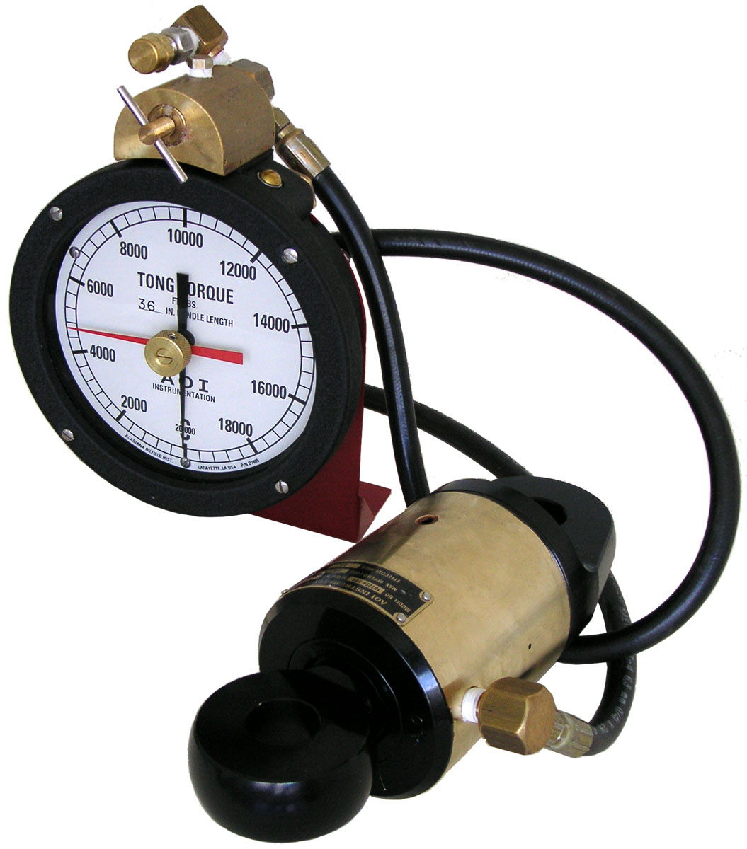
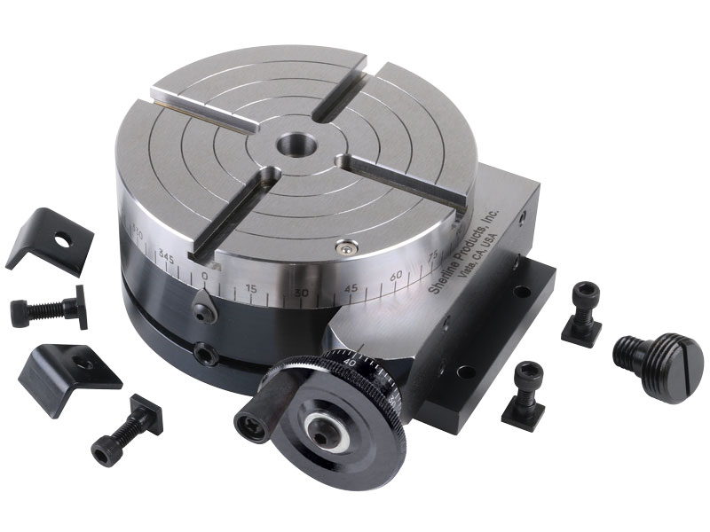
Drill Collars
Torque Indicators
Rotary Tables
Rotary Table Mat
Rotary swivels
Safety Clamps
Safety Joints
Safety Relief Valves
Slick line Units
Spiral Grapples & Controls
Spools for BOPs
Stabilizers
Stabbing Guides
Stretchers Marine Type
Sucker Rod
Tachometer Systems
Tag Lines
Thread Protectors
Traveling blocks
Tube Wipers
Twin Discs Clutches
Tubing Tongs
Tubing Spider
Well chokes,
Well equipment
Wireline
Wireline anchors

Slide 9



Our Partners

Slide 10
Contact
BC.1304209
P.O.Box: 21033, Ajman Free Zone
United Arab Emirates
Tel: +971 67434747, Mob: +971-508917969
Email: enquiry@rdco-me.com
Website: http://rdco-me.com

